Slide 1


MP3 CLOCK DESIGN

Slide 2
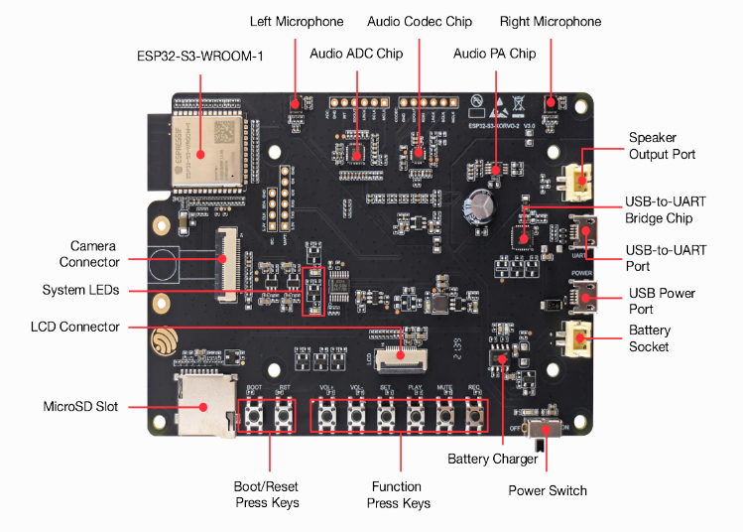
REFERENCE DESIGN
ESP32-S3-Korvo-2 V3.0
https://docs.espressif.com/projects/esp-adf/en/latest/design-guide/dev-boards/user-guide-esp32-s3-korvo-2.html

Slide 3
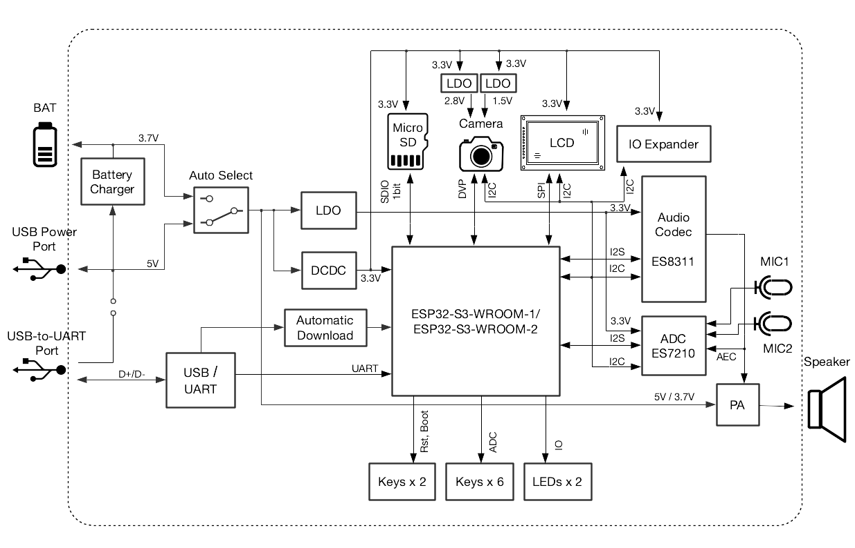
MODIFICATIONS

Slide 4
MODIFICATIONS
1. PCB size required (max): 40mm x 60mm
2. Remove microphones, ADC/Codec
3. Remove camera IO/connectors
4. Replace ES8311 with TAS5720M audio amplifier
5. Remove USB-UART and replace with UART TX/RX header
6. Remove 4 keys/buttons (leave 2 for volume up/down)
7. Remove USB 5V supply and battery charger circuit, and replace with 12V power supply unit and appropriate DC-DC conversion

